Slide 1
Admissions and Tuition Benefit Information Session
Presented by:
Office of Admissions, Financial Aid, and Human Resources
Furman University

Slide 2
The Admissions Process

Slide 3
The College Search
What to do after high school?
  College
  Military
  Employment
Which college is right for me?
  Connect with school counselor
  Connect with admissions counselor
  Online Research
  Campus Tours
  College Fairs
                Fit is also important

Slide 4
Furman University – Admissions Process
The office of Admissions may consider an array of factors in the admissions review process, with academic performance being a key consideration.
Academic Considerations (average) |  |  | Comments
Core Academic GPA: | 3.726 |  | The Office of Admissions re-calculates all GPAs to include only core academic courses (Math, Science, Social Studies, English, Foreign Language) and will use an unweighted, 4.0 scale when determining core GPA.
SC UGP GPA: | 4.831
Curriculum Rigor: | Considered within the context of a student’s high school. |  | Every high school is distinct in terms of the types of course offerings made available to students. We encourage students to pursue upper level coursework, whether it is AP, IB, Honors Levels, Dual Enrollment, or other upper level coursework determined at the individual school.
SAT Mid-50%: | 1300-1450 |  | Furman has been test optional since 2011, so it is up to the student to determine whether test scores should be a factor in review. Should students choose to include test scores for review, we will “super score” both the SAT and ACT. This means we will take the best subsection scores if exams have been taken multiple time to determine the highest composite score.
ACT Mid-50%: | 29 - 33
Additional Considerations May Include:
Extracurricular Involvement |  | Essay |  | Letters of Recommendation (not required)
Resume |  | Honors or Awards

Slide 5
Furman University – Admissions Process
Furman utilizes both the Common Application and Coalition Application for review. There is no preference and which platform to use may be a recommendation from the student’s school counselor or determined by the other institutions a student may be considering. For more details about our application process, please visit https://www.furman.edu/admissions-aid/apply/.
Furman’s Application Rounds – Important Dates & Deadlines
Application Round: | Early Decision I (Binding)* | Early Action | Early Decision II (Binding)* | Regular Decision
Application Deadline: | November 1 | November 1 | January 15 | January 15
Financial Aid Priority Deadline: | November 1 | November 15 | January 15 | February 1
Admissions Decision Notification: | By November 15 | By December 20 | By February 1 | By February 15
Financial Aid Notification: | By November 15 | By January 10 | By February 1 | By March 1
Enrollment Deadline: | January 5 | May 1 | March 1 | May 1
*Both Early Decision I and II are binding rounds, which means that if admitted, a student agrees to withdraw applications from admission to other institutions and commit to enroll at Furman

Slide 6
Tuition Exchange Programs

Slide 7
Tuition Exchange Programs
Two tuition exchange programs
  The Tuition Exchange (TE)
    700+ Member Institutions
    Value of the TE Scholarship is either full tuition or an annual set rate (depending on the school).
      For 2027-28, the set rate is $45,000
      Check with the participating institution regarding its TE award value
      Some institutions may use federal and state grant funds as part of the TE award package
    Furman pays the TE fee on behalf of each student accepted
  Associated Colleges of the South (ACS) Tuition Exchange
    17 ACS member institutions
    ACS award covers full tuition at the host institution
      Federal and state grants may be applied first, according to institutional policy
      Families pay a $2,000 annual ACS participation fee
      Furman pays a matching $2,000 annual ACS participation fee
      FAFSA application is required

Slide 8
ACS Participating Schools
No ACS Tuition
Exchange

Slide 9
Steps in the Process
The Furman employee initiates the process with Human Resources
  In early fall of your student’s senior year, complete Furman’s Tuition Benefits request form
HR will certify employee eligibility and notify Admissions of that status
Student applies for admission to TE/ACS Schools
  Apply for admission early fall (we suggest August/September)
  Complete the FAFSA (for ACS schools) starting October 1

Slide 10
Steps in the Process - Tuition Exchange
Furman employee must complete TE application online at the official TE website.
TE then notifies Furman that your TE application has been received
  Your TE application is approved if HR has your Furman Tuition Benefits Form, and you are deemed eligible by HR.
  TE application information is sent electronically to the schools you listed on the TE application. You should apply to several schools and can add schools after the initial application is submitted.
  You and Furman are notified if your student is awarded the TE scholarship by the school(s) to which your student applied.
    Notification timetable is school-dependent

Slide 11
Steps in the Process - ACS Exchange
Beth Anderson (Norris) completes ACS application online on your student’s behalf and according to the schools you listed on the Tuition Benefits Form (Notice that this is different than the TE application)
  You and Furman are notified by the importing school if your student is awarded ACS Tuition Exchange
  Notification timetable is school-dependent
Parent pays $2,000 fee to ACS by July 15 when accepted and committed to school.
  ACS will bill parents directly for this fee.
  If your school is an ACS and TE school, apply for both programs.

Slide 12
Remember…
Admission to TE/ACS schools is not guaranteed.
TE/ACS awards are not guaranteed.
If your student is awarded TE, certification of continued eligibility is required each year.
  Furman does this on your behalf, but you need to submit the tuition benefit form to HR first
Tuition Exchange programs are valid for 8 semesters – we recommend not using them for summer terms
If your student takes any college courses after high school graduation but before entering their freshman year of college, they are considered a transfer student and that may make them ineligible for the tuition exchange program. Check with the college they want to attend before allowing them to take courses to get ahead.
The Furman Tuition Benefit form must be completed each year and submitted to HR (August is recommended).
  You should notify HR of any change in your student’s enrollment, i.e. leave of absence, transferring, etc.

Slide 13
Tuition Benefits

Slide 14
Tuition Programs
Furman University Undergraduate and Graduate Programs
Tuition Exchange and ACS Exchange
Tuition Scholarship Grant
Job-Related Tuition Reimbursement

Slide 15
Eligibility Requirements
Faculty and Staff Requirements
  2 Years Continuous Service
    Family leave and sabbatical leave are not considered interruptions to continuous service
  Faculty – ¾ teaching load
  Staff – minimum of 30 work hours per week
Dependent Requirements
  Legal spouse/partner
  Dependent child – biological child, step-child, legally adopted child, child under legal guardianship
    under 24 years of age
    has not completed a bachelors level program

Slide 16
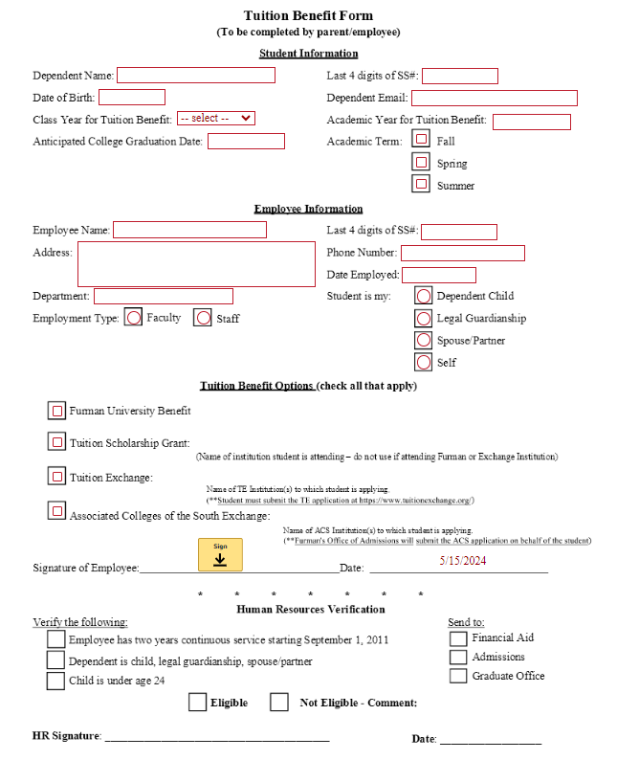
Link
Tuition Benefit form can be found at:
https://www.furman.edu/offices-services/human-resources/benefits/tuition-benefits/

Slide 17
Furman Undergraduate & Graduate Programs
(Available for employee, spouse, and dependent children)
Must be admitted through Office of Admissions or Office of Graduate Studies.
Tuition benefit does not include non-tuition charges such as fees, room and board, books, residence halls damage deposits, student insurance, ROTC deposit, courses taken on audit basis, and other special charges related to enrolling in the University.
Form: Submit once a year

Slide 18
Tuition Exchange & ACS Exchange
(Available for eligible dependent children only)
Eligibility in the exchange programs requires the dependent child meet the admission requirement and be pursuing their first undergraduate degree full-time during the regular school year (not summer school).
Eligible until 8 semesters are completed or fulfillment of undergraduate requirements, whichever comes first; not over age 23
Participating schools
  Tuition Exchange – www.tuitionexchange.org
  ACS – www.colleges.org
Form: Submit once a year

Slide 19
Tuition Scholarship Program
(Available for dependent children only)
Dependent must be enrolled full-time in a two-year or four-year accredited college or university pursing an undergraduate degree
Maximum award amount - $2,530 per year ($1,265/semester)
Eligible until 8 semesters are completed or fulfillment of bachelor’s degree requirements, whichever comes first.
Benefit can only be applied to tuition charges.
Form: Submit each semester

Slide 20
Job-Related Tuition Reimbursement
(Staff Only)
Available to full-time staff who attend accredited colleges and universities other than Furman.
Eligible courses:
  Job-related courses which apply to career opportunities available at Furman
  Courses that lead to an associate, undergraduate or graduate degree, provided the degree is related to opportunities within the University
  ‘Long-term” courses to obtain occupational certification that relate to job opportunities at Furman
Maximum award amount: $1,500 per year ($750/semester)
Form: Completed each semester

Slide 21
Questions?

